Slide 1
Moderatorul evenimentului: Prof. Univ. Dr. Farm. Dumitru LUPULEASA
Presedintele Colegiului Farmacistilor din Romania

Slide 3
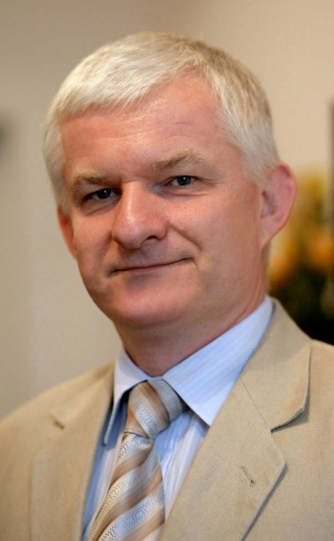
Invitat Special
Piotr Bohater
International Affairs Coordinator and Ex-Co member of the Polish Pharmaceutical Chamber.
From 2009 to 2012 was Ex-Co member of the Pharmaceutical Group of the European Union (PGEU) and in 2012 was Vice President of PGEU. Author of many publications concerning legislative and economic aspects of community pharmacy working. He has also been involved in implementation of electronic prescriptions and Anti-Counterfeiting Directive because he is not only graduate of the Faculty of Pharmacy at the Medical University in Wrocław but he is graduate of the Electronic Faculty at the Wrocław University of Technology as well.

Slide 4
Parteneri
MULTUMIM TUTUROR PARTENERILOR!

Slide 5
Tombola
TOMBOLA OFERITA DE:

